Slide 1


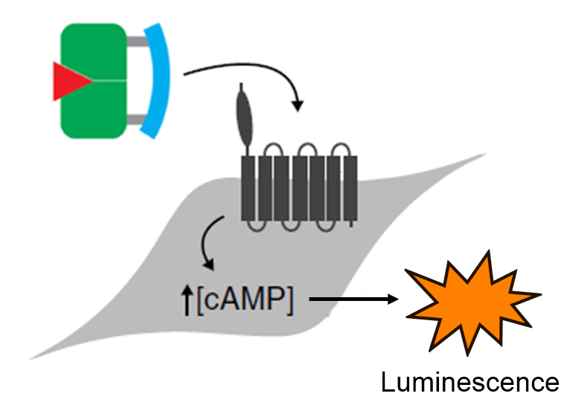
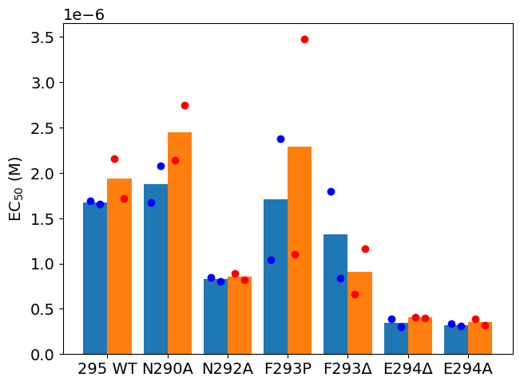
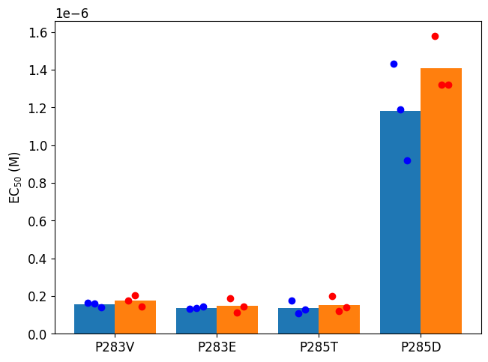
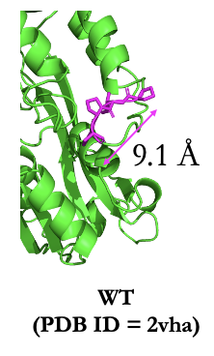
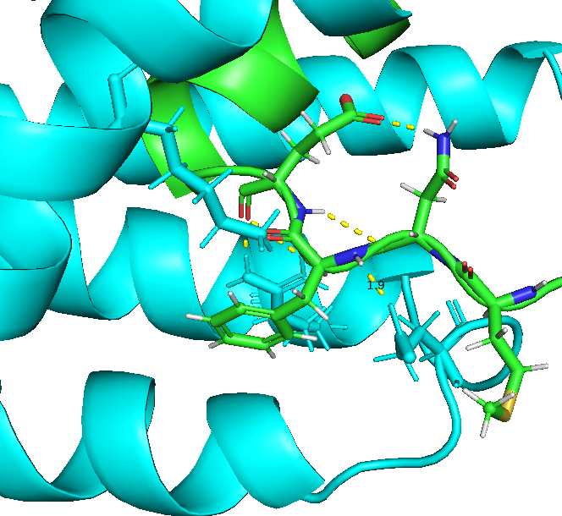
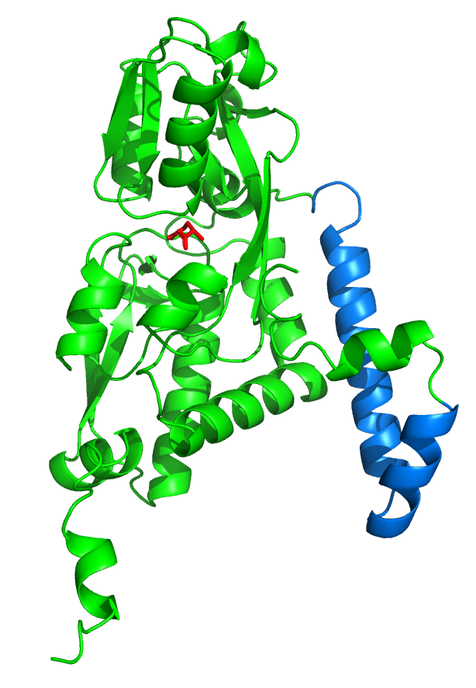

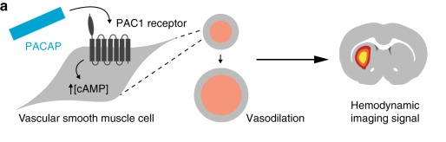
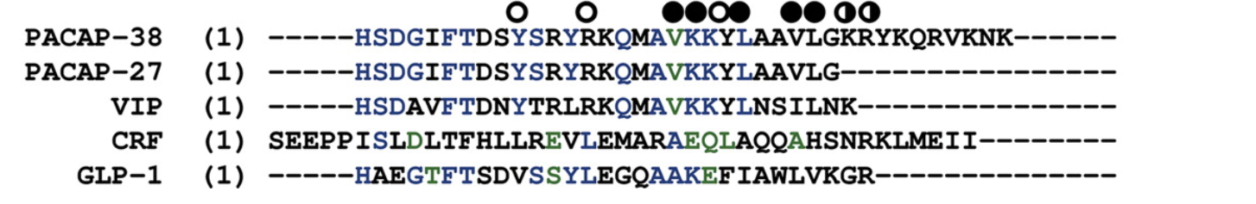
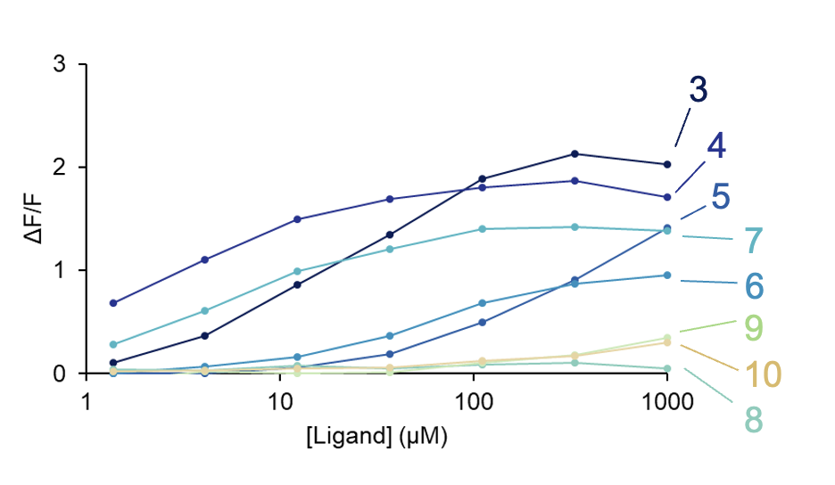
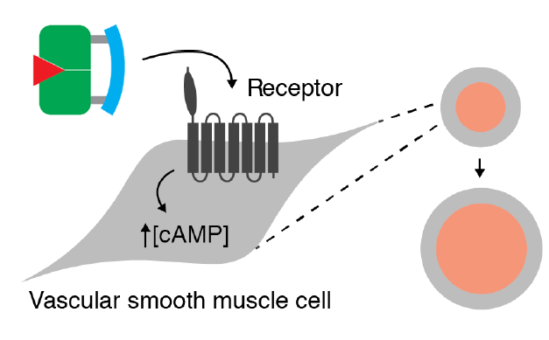
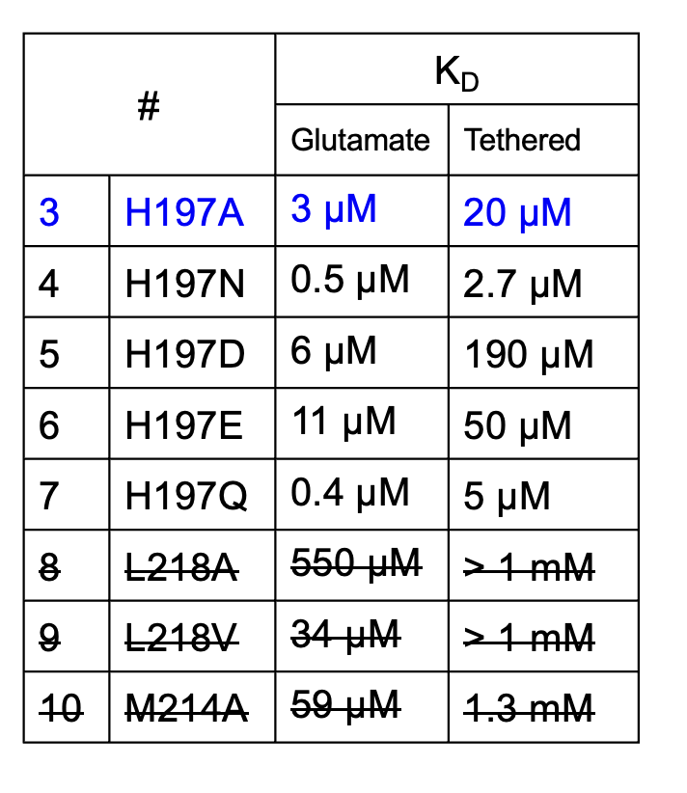
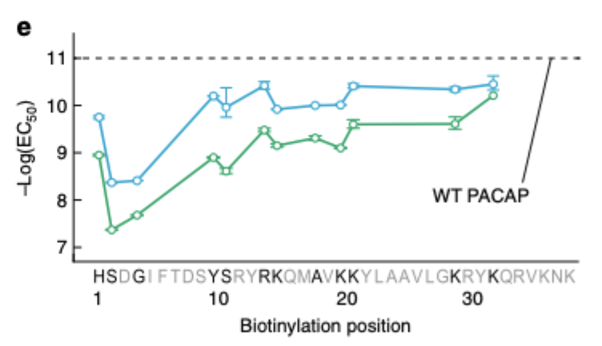
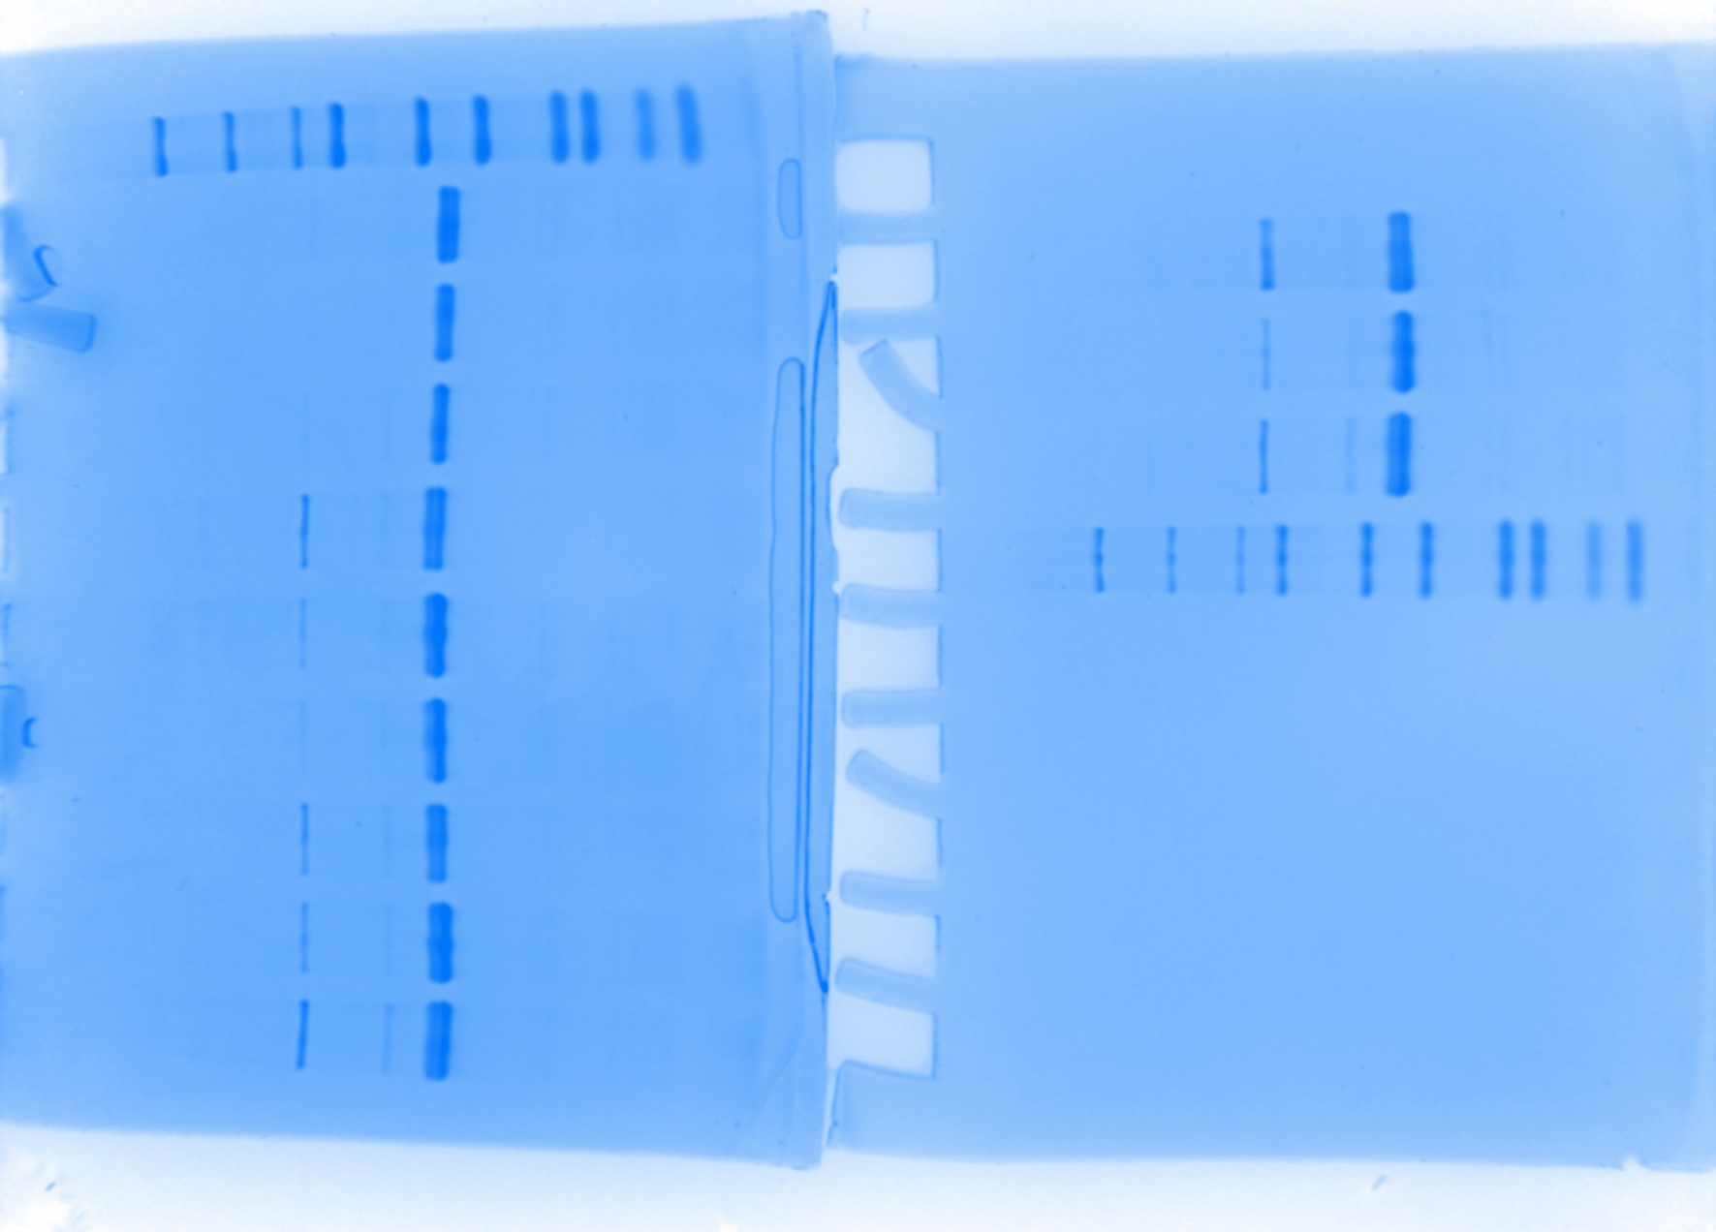
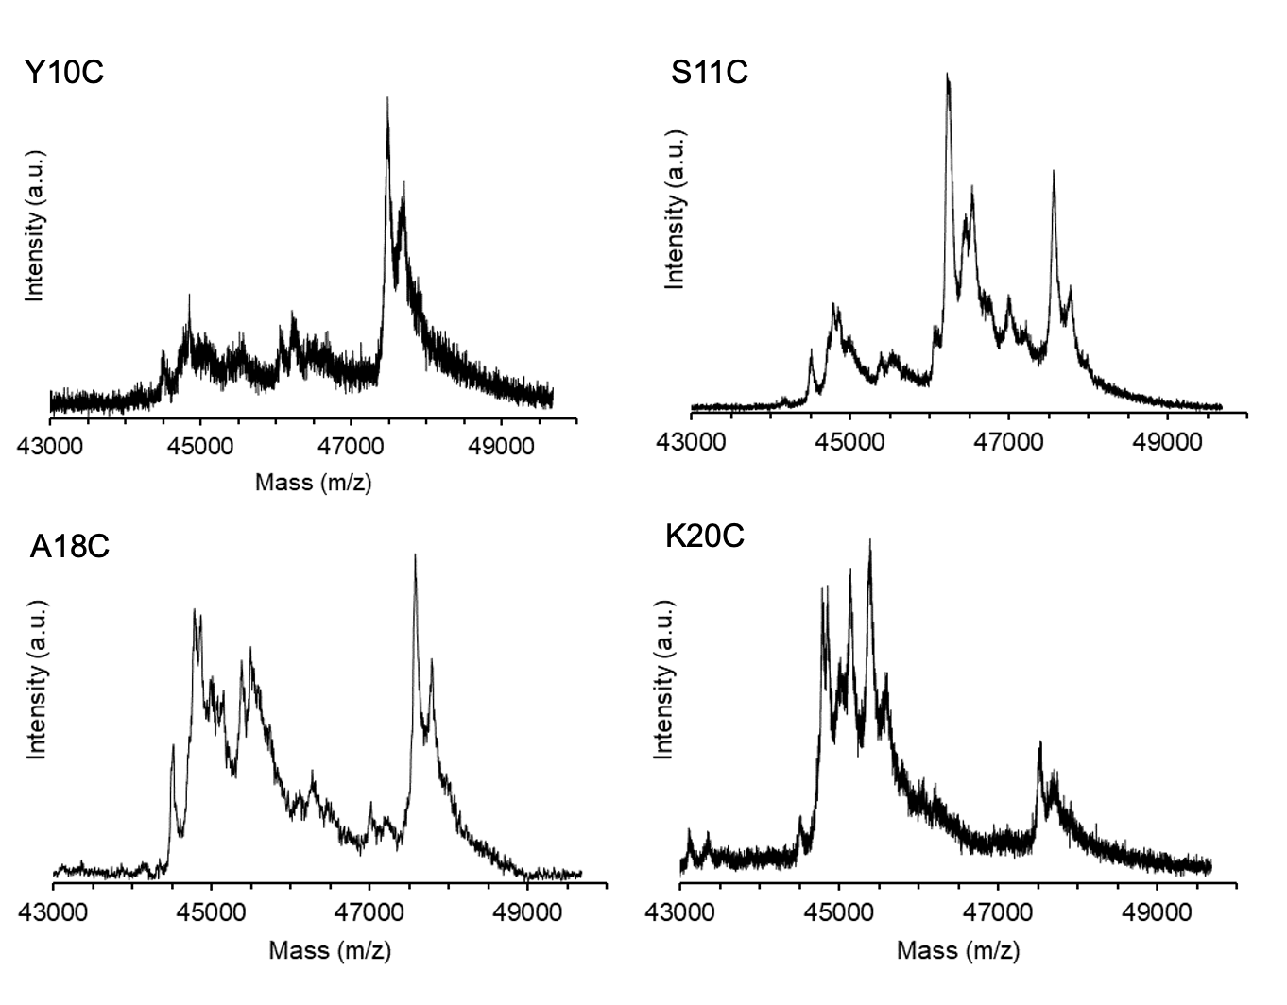
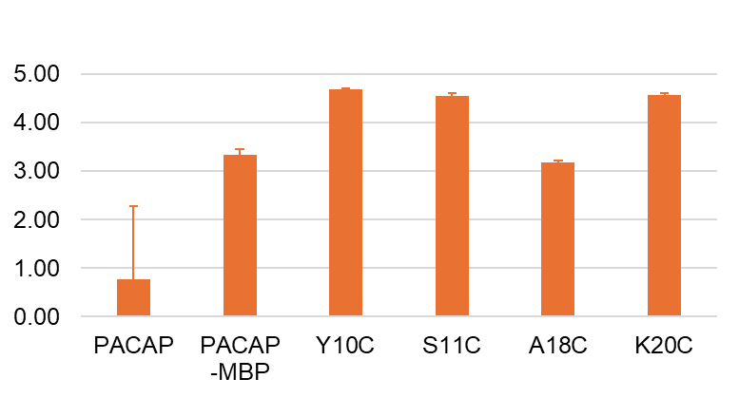
Glutamate-Responsive MRI Probe Engineered via Competitive GltI Binding
Emma Wang¹, LiLi Finch¹, Heather Jensen¹, Jeong Hoon Ko¹, Lindsey Guan², Amy Keating², Alan Jasanoff¹
¹Department of Brain and Cognitive Sciences and Department of Biological Engineering, and ²Department of Biology, Massachusetts Institute of Technology
MRI Vasoprobe for Glutamate Imaging
Prior PACAP Engineering Approach
Monitoring molecular neurotransmission within the brain helps understand the brain in healthy and disease states.
Glutamate is the most abundant excitatory neurotransmitter.
Magnetic Resonance Imaging (MRI): non-invasive, offers high spatiotemporal resolution.
Vasoprobes: trigger vasodilation when bound to the target neurotransmitter, which creates MRI signal.
Goal: engineer a vasoprobe that generates glutamate-dependent MRI signal.
Glutamate binding protein GltI + vasoactive pituitary adenylate cyclase-activating polypeptide (PACAP) =Glutamate activatable vasoprobe for analyte targeting (GluAVATar)
Previously, we structurally identified two strategies to engineer the region near the N-terminus of the PACAP to achieve glutamate responsiveness.
PACAP
295’s polar interaction between N292/E294.
Green: N-terminus of PACAP, blue: PAC1R.
EC₅₀(M)
GluAVATar binding to PAC1R => Luminescence
We measured vasodilating activity in Chinese hamster ovary (CHO) cells that express PAC1R and cAMP-dependent luciferase.
Polar Interaction Disruption’s Effect on 295 EC50
AF2 predicted structure of GluAVATar bound to glutamate (red), consisting of GltI (green) and PACAP (blue) domains
PACAP binding to PAC1R in the presence of glutamate triggers vasodilation
Although this approach did not yield glutamate responsiveness, it revealed structure-function insights about vasodilating activity
Tethered-Glutamate Strategy
Cysteine Mutated PACAP-MBP Mutants Design
Low Glutamate Concentrations
High Glutamate Concentrations
Based on past literature on PACAP-PAC1R binding, we selected residues for cysteine mutation that avoids decreasing PACAP-PAC1R binding.
Tethered glutamate on PACAP binds to GltI
prevents PACAP from interacting with PAC1R
- Free glutamate outcompetes the tethered version for GltI binding.
- GltI releases PACAP, freeing it to bind to PAC1R.
No vasodilation and MRI signal
Vasodilation and MRI signal
The secondary structure for hPAC1-R_{S} is indicated above the sequence. The results from the mutational data are summarized by using open, half-filled, and filled circles to indicate no effect, 3- to 5-fold, and >5-fold decrease in binding, respectively, upon mutation of the residue.
Assessing GltI Mutant Binding via Fluorescence
Glutamate
Glutamate Tether
Inactive
sensor
GltI Mutants Binding Affinity to Glutamate and Tethered-Glutamate
Sun, Chaohong et al. PNAS vol. 104,19 (2007): 7875-80.
Active
sensor
EC50 of Biotin-Tethered PACAP Binding Competitively to GltI
Glutamate
We will attach tethered glutamate to PACAP through cysteine-maleimide chemistry:
PACAP
+
PACAP
H197A was selected as the optimal GltI mutant due to the combination of its glutamate binding profile and robust fluorescence signal.
Glutamate
Ohlendorf, R. et al. Nature communications vol. 11,1 2399. 13 May. 2020.
Evaluating Cysteine Truncation and PACAP Binding in PACAP-MBP Mutants
Future Directions
250kD
Cysteine PACAP Mutants Luminescence EC50 (n=3)
Attach glutamate to cysteine mutants.
Test glutamate dependent mutant activity in CHO cell luminescence assay.
Design and test fusion design (tethered glutamate PACAP fused to GltI)
Delivering the product across the blood-brain-barrier.
150kD
We verified cysteine presence using Ellman’s Assay. Signal was detected in S2C while no signal was detected in PACAP-MBP (negative control)
100kD
10⁻⁷
75kD
50kD
10⁻⁸
S2C G4C D8C Y10C S11C R12C Y13C R14C A18C K20C K21C K32C
37kD
25kD
10⁻⁹
20kD
EC₅₀ (M)
15kD
10kD
10⁻¹⁰
S2C G4C D8C Y10C S11C R12C Y13C R14C A18C K20C K21C K32C
10⁻¹¹
Protein Polyacrylamide Gel of Cysteine—PACAP mutants
Major bands ~ 48kD
10⁻¹²
Acknowledgements
We expressed mutants and observed smaller bands from the gel and suspected cysteine truncation from expressing in E. coli.
MALDI Spectrum
Despite signs of cysteine truncation in E. coli expression, MALDI confirmed full-length products for select mutants.
A18C retained sufficient PAC1R activity for functional testing, supporting its use in future steps.
This work was supported by NIH U01 EB031641.

